Slide 1
Convolutional Neural Networks
Shangsong Liang
Machine Learning, SYSU

Slide 2
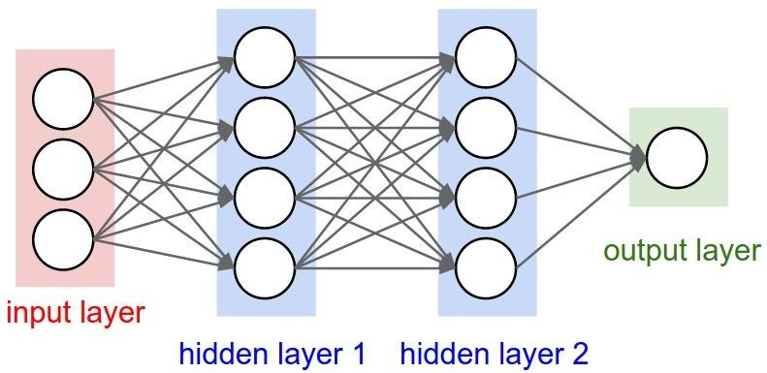
Mini-batch SGD
Loop:
Sample a batch of data
Forward prop it through the graph, get loss
Backprop to calculate the gradients
Update the parameters using the gradient

Slide 3
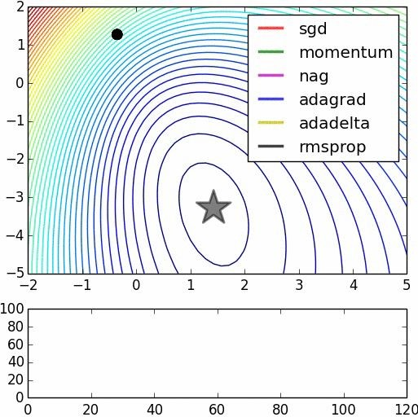
Parameter updates
We covered: sgd, momentum, nag, adagrad, rmsprop,
adam (not in this vis),
we did not cover adadelta
Image credits: Alec Radford

Slide 4
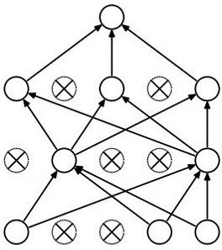
Dropout
Forces the network to have a redundant representation.
has an ear
has a tail is furry has claws
mischievous X
look
X
X
cat score

Slide 5
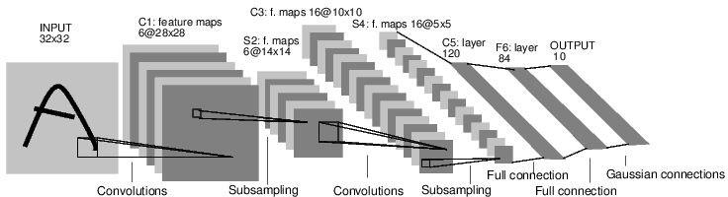
Convolutional Neural Networks
[LeNet-5, LeCun 1980]

Slide 6
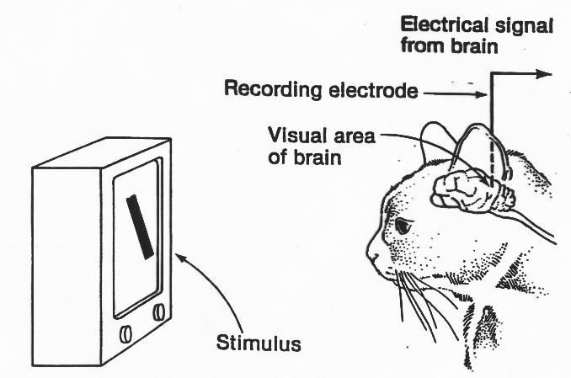
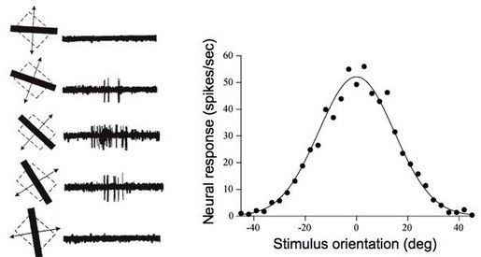
A bit of history:
Hubel & Wiesel, 1959
RECEPTIVE FIELDS OF SINGLE NEURONES IN
THE CAT'S STRIATE CORTEX
1962
RECEPTIVE FIELDS, BINOCULAR INTERACTION
AND FUNCTIONAL ARCHITECTURE IN THE CAT'S VISUAL CORTEX
1968...

Slide 7
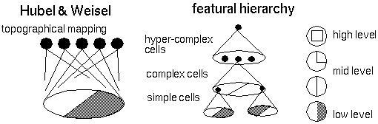
Hierarchical organization

Slide 8
Convolutional Neural Networks
(First without the brain stuff)

Slide 9
Convolution Layer
32x32x3 image
32
height
32
depth
width
3

Slide 10
Convolution Layer
32x32x3 image
5x5x3 filter
32
Convolve the filter with the image
i.e. “slide over the image spatially, computing dot products”
32
3

Slide 11
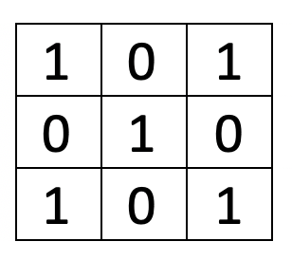
Convolution

Slide 12
Convolution Layer
Filters always extend the full depth of the input volume
32x32x3 image
5x5x3 filter
32
Convolve the filter with the image
i.e. “slide over the image spatially, computing dot products”
32
3

Slide 13


Convolution Layer
32x32x3 image 5x5x3 filter
32
1 number:
the result of taking a dot product between the filter and a small 5x5x3 chunk of the image
(i.e. 5*5*3 = 75-dimensional dot product + bias)
32
3

Slide 14
Convolution Layer
activation map
32x32x3 image 5x5x3 filter
32
28
convolve (slide) over all spatial locations
32
28
3
1

Slide 15
consider a second, green filter
Convolution Layer
32x32x3 image 5x5x3 filter
activation maps
32
28
convolve (slide) over all spatial locations
32
28
3
1

Slide 16
For example, if we had 6 5x5 filters, we’ll get 6 separate activation maps:
activation maps
32
28
Convolution Layer
32
28
3
6
We stack these up to get a “new image” of size 28x28x6!

Slide 17
Preview: ConvNet is a sequence of Convolution Layers, interspersed with activation functions
32
28
CONV, ReLU
e.g. 6 5x5x3 filters
32
28
3
6

Slide 18
Preview: ConvNet is a sequence of Convolutional Layers, interspersed with activation functions
32
28
24
….
CONV, ReLU
e.g. 6 5x5x3 filters
CONV, ReLU
e.g. 10 5x5x6 filters
CONV, ReLU
32
28
24
3
6
10

Slide 19
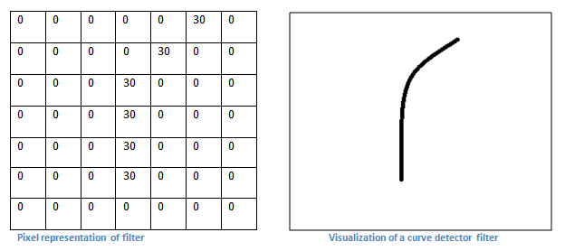
Convolution (conv) layer Idea of a feature identifier
We would like to extract a curve (feature) from the image

Slide 20
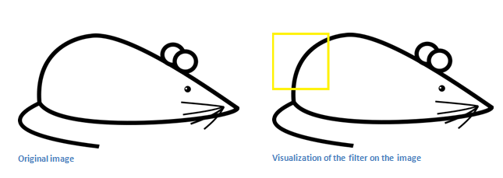
Convolution (conv) layer The curve feature in an image
So for this part of the image, there is such as a curve feature to be found.

Slide 21
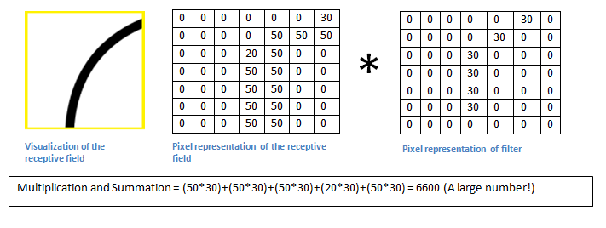
Exercises on CNN Exercise 1: Convolution (conv) layer How to find the curve feature
We use convolution (see appendix).
The large output after convolution of the images A and B B=flipped feature mask) shows the window has such a curve
Exercise 1: If B=B_{new} , find Multi_and_Sum.
Answer_________?
We can interpret the receptive field (A) as the input image, the flipped filter mask (B) as the weights in a neural network.
=A
=B
=B_{new} (empty cell = 0)
 | 30
 |  | 30
 |  |  | 30
 |  |  | 30
 |  |  | 30
 |  |  | 30
 |  |  | 30
Multi_and_Sum

Slide 22
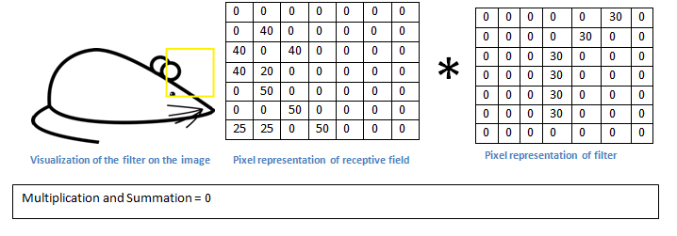
Convolution (conv) layer : In this part of the image, the curve feature is not found (convolution =0), so this window has no such a curve feature

Slide 23
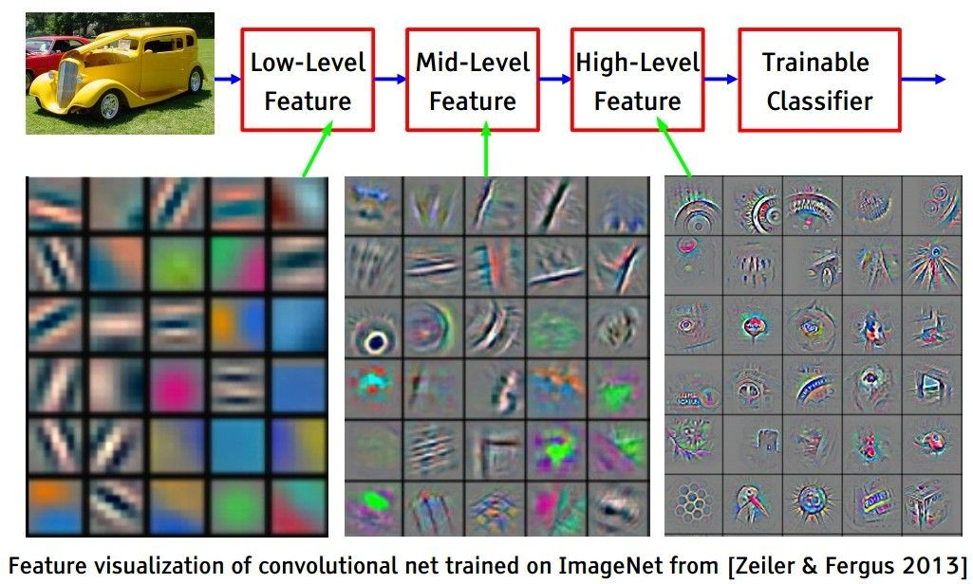
[From recent Yann LeCun slides]
Preview

Slide 24
[From recent Yann LeCun slides]
Preview

Slide 25
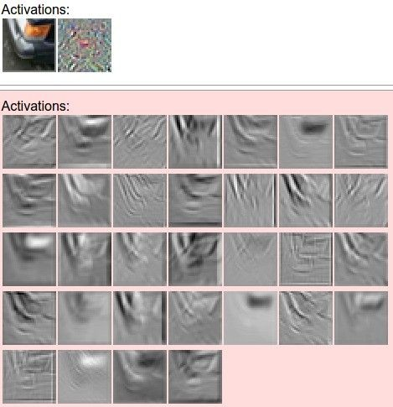

one filter =>
one activation map
example 5x5 filters
(32 total)
We call the layer convolutional because it is related to convolution of two signals:
elementwise multiplication and sum of a filter and the signal (image)

Slide 26
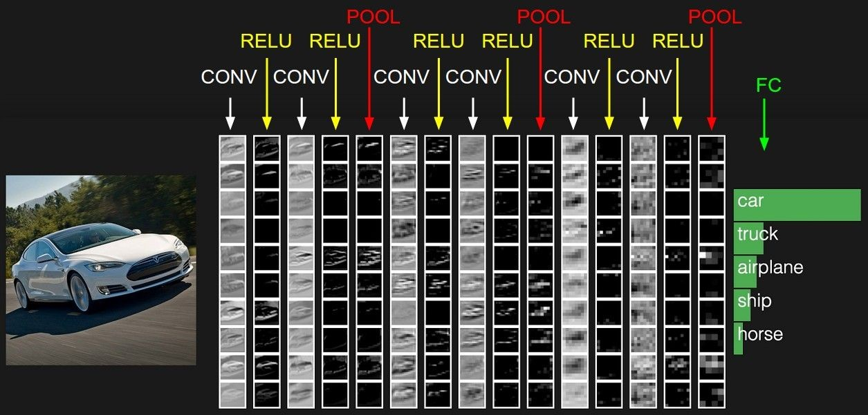
preview:

Slide 27
A closer look at spatial dimensions:
activation map
32x32x3 image 5x5x3 filter
32
28
convolve (slide) over all spatial locations
32
28
3
1

Slide 28
Convoluation
Stride is the size of the step the convolution filter moves each time.

Slide 29
Convoluation
Padding: Feature map is always smaller than the input. Do something to prevent our feature map from shrinking.

Slide 30
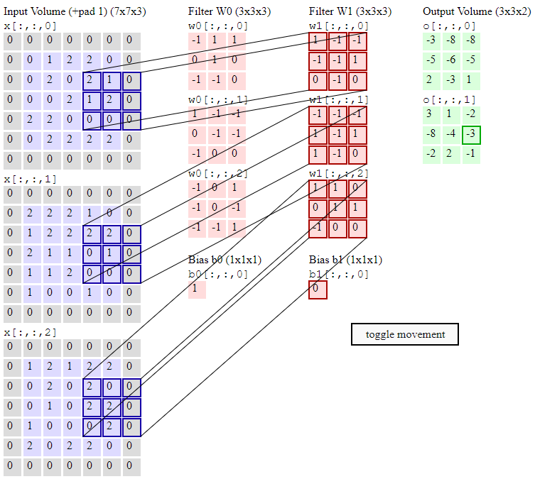

Slide 31
A closer look at spatial dimensions:
7
7x7 input (spatially) assume 3x3 filter
7

Slide 32
A closer look at spatial dimensions:
7
7x7 input (spatially) assume 3x3 filter
7

Slide 33
A closer look at spatial dimensions:
7
7x7 input (spatially) assume 3x3 filter
7

Slide 34
A closer look at spatial dimensions:
7
7x7 input (spatially) assume 3x3 filter
7

Slide 35
A closer look at spatial dimensions:
7
7x7 input (spatially) assume 3x3 filter
=> 5x5 output
7

Slide 36
A closer look at spatial dimensions:
7
7x7 input (spatially) assume 3x3 filter applied with stride 2
7

Slide 37
A closer look at spatial dimensions:
7
7x7 input (spatially) assume 3x3 filter applied with stride 2
7

Slide 38
A closer look at spatial dimensions:
7
7x7 input (spatially) assume 3x3 filter applied with stride 2
=> 3x3 output!
7

Slide 39
A closer look at spatial dimensions:
7
7x7 input (spatially) assume 3x3 filter applied with stride 3?
7

Slide 40
A closer look at spatial dimensions:
7
7x7 input (spatially) assume 3x3 filter applied with stride 3?
7
doesn’t fit!
cannot apply 3x3 filter on 7x7 input with stride 3.

Slide 41
N
Output size:
(N - F) / stride + 1
 |  |  | F
 | F
e.g. N = 7, F = 3:
stride 1 => (7 - 3)/1 + 1 = 5
stride 2 => (7 - 3)/2 + 1 = 3
stride 3 => (7 - 3)/3 + 1 = 2.33 :\
N

Slide 42
In practice: Common to zero pad the border
0 | 0 | 0 | 0 | 0 | 0
0
0
0
0
e.g. input 7x7
3x3 filter, applied with stride 1
pad with 1 pixel border => what is the output?
(recall:)
(N - F) / stride + 1

Slide 43
In practice: Common to zero pad the border
0 | 0 | 0 | 0 | 0 | 0
0
0
0
0
e.g. input 7x7
3x3 filter, applied with stride 1
pad with 1 pixel border => what is the output?
7x7 output!

Slide 44
In practice: Common to zero pad the border
0 | 0 | 0 | 0 | 0 | 0
0
0
0
0
e.g. input 7x7
3x3 filter, applied with stride 1
pad with 1 pixel border => what is the output?
7x7 output!
in general, common to see CONV layers with stride 1, filters of size FxF, and zero-padding with (F-1)/2. (will preserve size spatially)
e.g. F = 3 => zero pad with 1 F = 5 => zero pad with 2 F = 7 => zero pad with 3

Slide 45
Remember back to…
E.g. 32x32 input convolved repeatedly with 5x5 filters shrinks volumes spatially! (32 -> 28 -> 24 ...). Shrinking too fast is not good, doesn’t work well.
32
28
24
….
CONV, ReLU
e.g. 6 5x5x3 filters
CONV, ReLU
e.g. 10 5x5x6 filters
CONV, ReLU
32
28
24
3
6
10

Slide 46
Examples time:
Input volume: 32x32x3
10 5x5 filters with stride 1, pad 2
Output volume size: ?

Slide 47
Examples time:
Input volume: 32x32x3
10 5x5 filters with stride 1, pad 2
Output volume size:
(32+2*2-5)/1+1 = 32 spatially, so
32x32x10

Slide 48
Examples time:
Input volume: 32x32x3
10 5x5 filters with stride 1, pad 2
Number of parameters in this layer?

Slide 49
Examples time:
Input volume: 32x32x3
10 5x5 filters with stride 1, pad 2
Number of parameters in this layer? each filter has 5*5*3 + 1 = 76 params
=> 76*10 = 760
(+1 for bias)

Slide 50
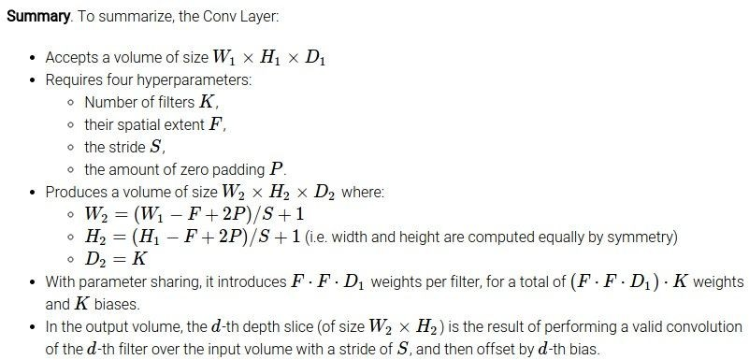

Slide 51
Common settings:
K = (powers of 2, e.g. 32, 64, 128, 512)
- F = 3, S = 1, P = 1
- F = 5, S = 1, P = 2
- F = 5, S = 2, P = ? (whatever fits)
- F = 1, S = 1, P = 0

Slide 52
(btw, 1x1 convolution layers make perfect sense)
1x1 CONV
with 32 filters
56
56
(each filter has size 1x1x64, and performs a 64-dimensional dot product)
56
56
64
32

Slide 53
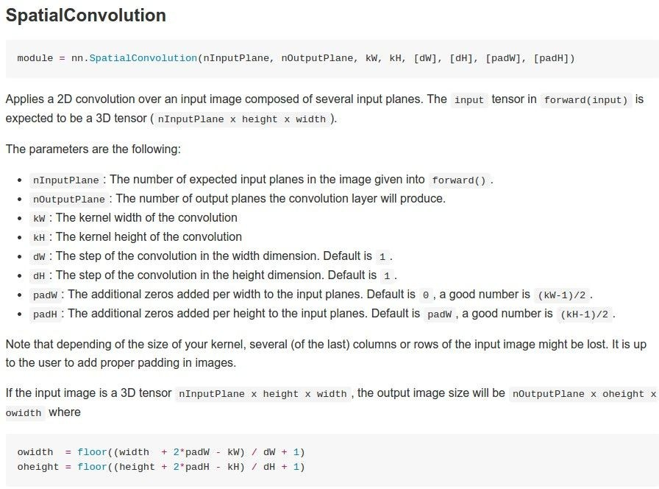
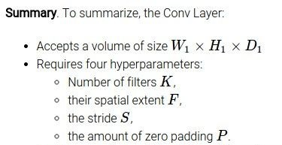
Example: CONV layer in Torch

Slide 54
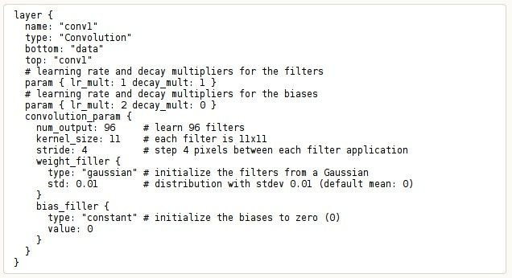
Example: CONV layer in Caffe

Slide 55
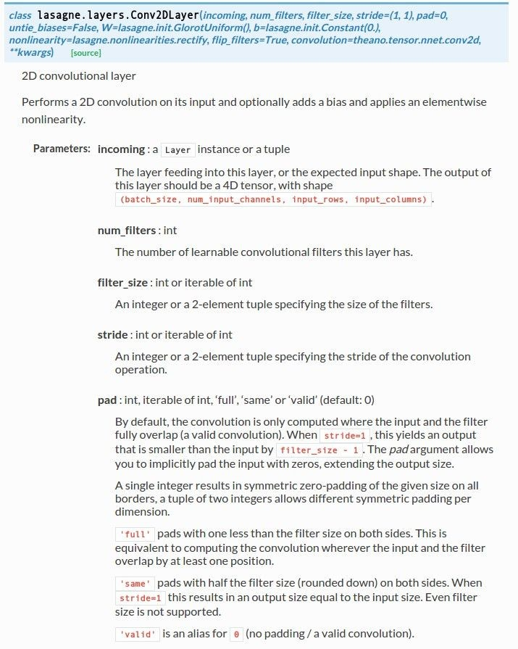
Example: CONV layer in Lasagne

Slide 56
The brain/neuron view of CONV Layer
32x32x3 image 5x5x3 filter
32
1 number:
the result of taking a dot product between the filter and this part of the image
(i.e. 5*5*3 = 75-dimensional dot product)
32
3

Slide 57
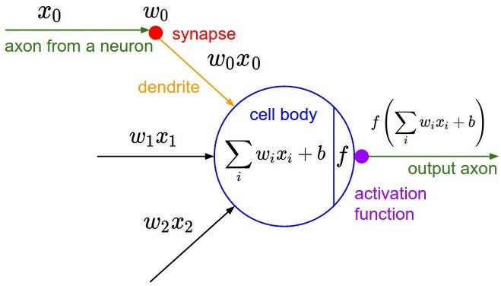
The brain/neuron view of CONV Layer
32x32x3 image 5x5x3 filter
32
It’s just a neuron with local connectivity...
1 number:
the result of taking a dot product between the filter and this part of the image
(i.e. 5*5*3 = 75-dimensional dot product)
32
3

Slide 58
The brain/neuron view of CONV Layer
32
28
An activation map is a 28x28 sheet of neuron outputs:
Each is connected to a small region in the input
All of them share parameters
32
28
“5x5 filter” -> “5x5 receptive field for each neuron”
3

Slide 59
The brain/neuron view of CONV Layer
32
E.g. with 5 filters,
CONV layer consists of neurons arranged in a 3D grid (28x28x5)
28
There will be 5 different neurons all looking at the same region in the input volume
32
28
3
5

Slide 60
two more layers to go: POOL/FC

Slide 61
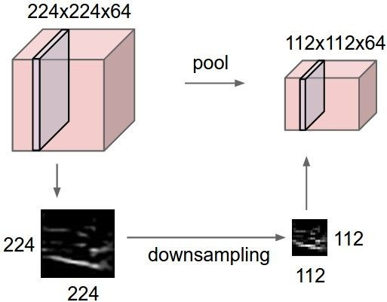
Pooling layer
makes the representations smaller and more manageable
operates over each activation map independently:

Slide 62
MAX POOLING
Single depth slice
1 | 1 | 2 | 4
5 | 6 | 7 | 8
3 | 2 | 1 | 0
1 | 2 | 3 | 4
x
max pool with 2x2 filters and stride 2
6 | 8
3 | 4
y

Slide 63
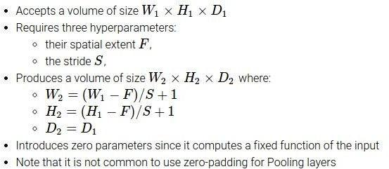

Slide 64
Common settings:
F = 2, S = 2
F = 3, S = 2

Slide 65
Fully Connected Layer (FC layer)
- Contains neurons that connect to the entire input volume, as in ordinary Neural Networks

Slide 66
Example Architecture
INPUT [32x32x3] will hold the raw pixel values of the image, in this case an image of width 32, height 32, and with three color channels R,G,B.
CONV layer will compute the output of neurons that are connected to local regions in the input, each computing a dot product between their weights and a small region they are connected to in the input volume. This may result in volume such as [32x32x12] if we decided to use 12 filters.

Slide 67
Example Architecture
RELU layer will apply an elementwise activation function, such as the max(0,x) thresholding at zero. This leaves the size of the volume unchanged ([32x32x12]).
POOL layer will perform a downsampling operation along the spatial dimensions (width, height), resulting in volume such as [16x16x12].

Slide 68
Example Architecture
FC (i.e. fully-connected) layer will compute the class scores, resulting in volume of size [1x1x10], where each of the 10 numbers correspond to a class score, such as among the 10 categories of CIFAR-10. As with ordinary Neural Networks and as the name implies, each neuron in this layer will be connected to all the numbers in the previous volume.

Slide 69
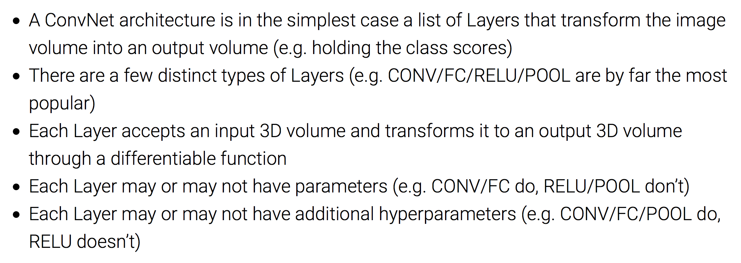
Summary of Example Architecture

Slide 70
[ConvNetJS demo: training on CIFAR-10]
http://cs.stanford.edu/people/karpathy/convnetjs/demo/cifar10.html

Slide 71
Case Study: LeNet-5
[LeCun et al., 1998]
Conv filters were 5x5, applied at stride 1
Subsampling (Pooling) layers were 2x2 applied at stride 2
i.e. architecture is [CONV-POOL-CONV-POOL-CONV-FC]

Slide 72
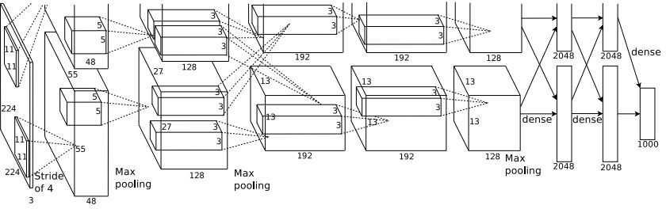
Case Study: AlexNet
[Krizhevsky et al. 2012]
Input: 227x227x3 images
First layer (CONV1): 96 11x11 filters applied at stride 4
=>
Q: what is the output volume size? Hint: (227-11)/4+1 = 55

Slide 73
Case Study: AlexNet
[Krizhevsky et al. 2012]
Input: 227x227x3 images
First layer (CONV1): 96 11x11 filters applied at stride 4
=>
Output volume [55x55x96]
Q: What is the total number of parameters in this layer?

Slide 74
Case Study: AlexNet
[Krizhevsky et al. 2012]
Input: 227x227x3 images
First layer (CONV1): 96 11x11 filters applied at stride 4
=>
Output volume [55x55x96]
Parameters: (11*11*3)*96 = 35K

Slide 75
Case Study: AlexNet
[Krizhevsky et al. 2012]
Input: 227x227x3 images After CONV1: 55x55x96
Second layer (POOL1): 3x3 filters applied at stride 2 Q: what is the output volume size? Hint: (55-3)/2+1 = 27

Slide 76
Case Study: AlexNet
[Krizhevsky et al. 2012]
Input: 227x227x3 images After CONV1: 55x55x96
Second layer (POOL1): 3x3 filters applied at stride 2 Output volume: 27x27x96
Q: what is the number of parameters in this layer?

Slide 77
Case Study: AlexNet
[Krizhevsky et al. 2012]
Input: 227x227x3 images After CONV1: 55x55x96
Second layer (POOL1): 3x3 filters applied at stride 2 Output volume: 27x27x96
Parameters: 0!

Slide 78
Case Study: AlexNet
[Krizhevsky et al. 2012]
Input: 227x227x3 images After CONV1: 55x55x96 After POOL1: 27x27x96
...

Slide 79
Case Study: AlexNet
[Krizhevsky et al. 2012]
Full (simplified) AlexNet architecture: [227x227x3] INPUT
[55x55x96] CONV1: 96 11x11 filters at stride 4, pad 0 [27x27x96] MAX POOL1: 3x3 filters at stride 2 [27x27x96] NORM1: Normalization layer
[27x27x256] CONV2: 256 5x5 filters at stride 1, pad 2 [13x13x256] MAX POOL2: 3x3 filters at stride 2 [13x13x256] NORM2: Normalization layer [13x13x384] CONV3: 384 3x3 filters at stride 1, pad 1 [13x13x384] CONV4: 384 3x3 filters at stride 1, pad 1 [13x13x256] CONV5: 256 3x3 filters at stride 1, pad 1 [6x6x256] MAX POOL3: 3x3 filters at stride 2
[4096] FC6: 4096 neurons
[4096] FC7: 4096 neurons
[1000] FC8: 1000 neurons (class scores)

Slide 80
Case Study: AlexNet
[Krizhevsky et al. 2012]
Full (simplified) AlexNet architecture: [227x227x3] INPUT
[55x55x96] CONV1: 96 11x11 filters at stride 4, pad 0 [27x27x96] MAX POOL1: 3x3 filters at stride 2 [27x27x96] NORM1: Normalization layer
[27x27x256] CONV2: 256 5x5 filters at stride 1, pad 2 [13x13x256] MAX POOL2: 3x3 filters at stride 2 [13x13x256] NORM2: Normalization layer [13x13x384] CONV3: 384 3x3 filters at stride 1, pad 1 [13x13x384] CONV4: 384 3x3 filters at stride 1, pad 1 [13x13x256] CONV5: 256 3x3 filters at stride 1, pad 1 [6x6x256] MAX POOL3: 3x3 filters at stride 2
Details/Retrospectives:
first use of ReLU
used Norm layers (not common anymore)
heavy data augmentation
dropout 0.5
batch size 128
SGD Momentum 0.9
Learning rate 1e-2, reduced by 10 manually when val accuracy plateaus
L2 weight decay 5e-4
[4096] FC6: 4096 neurons
[4096] FC7: 4096 neurons
[1000] FC8: 1000 neurons (class scores)
- 7 CNN ensemble: 18.2% -> 15.4%

Slide 81
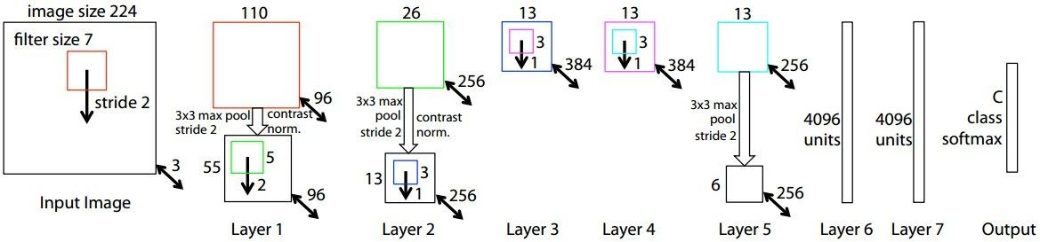
Case Study: ZFNet
[Zeiler and Fergus, 2013]
AlexNet but:
CONV1: change from (11x11 stride 4) to (7x7 stride 2) CONV3,4,5: instead of 384, 384, 256 filters use 512, 1024, 512
ImageNet top 5 error: 15.4% -> 14.8%

Slide 82
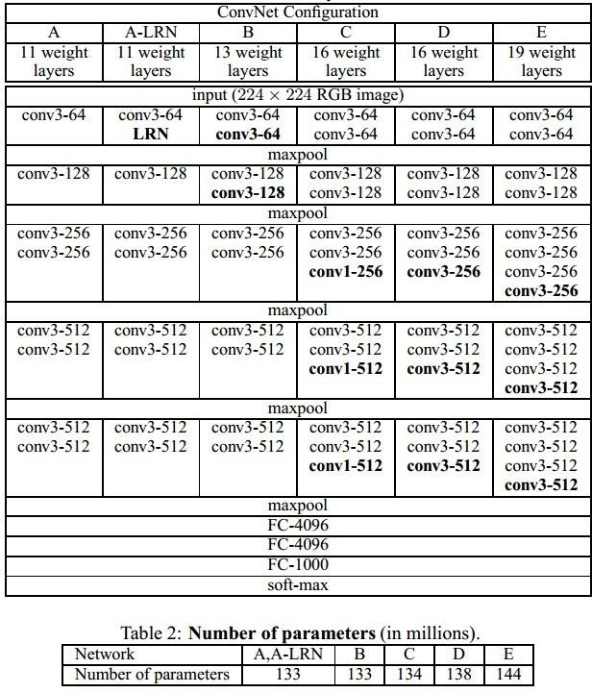
Case Study: VGGNet
[Simonyan and Zisserman, 2014]
Only 3x3 CONV stride 1, pad 1 and 2x2 MAX POOL stride 2
best model
11.2% top 5 error in ILSVRC 2013
->
7.3% top 5 error

Slide 83
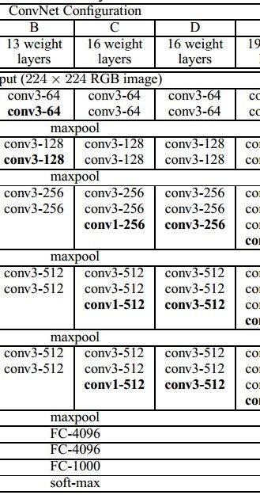
(not counting biases)
INPUT: [224x224x3] memory: 224*224*3=150K params: 0
CONV3-64: [224x224x64] memory: 224*224*64=3.2M params: (3*3*3)*64 = 1,728 CONV3-64: [224x224x64] memory: 224*224*64=3.2M params: (3*3*64)*64 = 36,864
POOL2: [112x112x64] memory: 112*112*64=800K params: 0
CONV3-128: [112x112x128] memory: 112*112*128=1.6M params: (3*3*64)*128 = 73,728 CONV3-128: [112x112x128] memory: 112*112*128=1.6M params: (3*3*128)*128 = 147,456
POOL2: [56x56x128] memory: 56*56*128=400K params: 0
CONV3-256: [56x56x256] memory: 56*56*256=800K params: (3*3*128)*256 = 294,912 CONV3-256: [56x56x256] memory: 56*56*256=800K params: (3*3*256)*256 = 589,824 CONV3-256: [56x56x256] memory: 56*56*256=800K params: (3*3*256)*256 = 589,824
POOL2: [28x28x256] memory: 28*28*256=200K params: 0
CONV3-512: [28x28x512] memory: 28*28*512=400K params: (3*3*256)*512 = 1,179,648 CONV3-512: [28x28x512] memory: 28*28*512=400K params: (3*3*512)*512 = 2,359,296 CONV3-512: [28x28x512] memory: 28*28*512=400K params: (3*3*512)*512 = 2,359,296
POOL2: [14x14x512] memory: 14*14*512=100K params: 0
CONV3-512: [14x14x512] memory: 14*14*512=100K params: (3*3*512)*512 = 2,359,296 CONV3-512: [14x14x512] memory: 14*14*512=100K params: (3*3*512)*512 = 2,359,296 CONV3-512: [14x14x512] memory: 14*14*512=100K params: (3*3*512)*512 = 2,359,296
POOL2: [7x7x512] memory: 7*7*512=25K params: 0
FC: [1x1x4096] memory: 4096 params: 7*7*512*4096 = 102,760,448 FC: [1x1x4096] memory: 4096 params: 4096*4096 = 16,777,216
FC: [1x1x1000] memory: 1000 params: 4096*1000 = 4,096,000

Slide 84
(not counting biases)
INPUT: [224x224x3] memory: 224*224*3=150K params: 0
CONV3-64: [224x224x64] memory: 224*224*64=3.2M params: (3*3*3)*64 = 1,728 CONV3-64: [224x224x64] memory: 224*224*64=3.2M params: (3*3*64)*64 = 36,864
POOL2: [112x112x64] memory: 112*112*64=800K params: 0
CONV3-128: [112x112x128] memory: 112*112*128=1.6M params: (3*3*64)*128 = 73,728 CONV3-128: [112x112x128] memory: 112*112*128=1.6M params: (3*3*128)*128 = 147,456
POOL2: [56x56x128] memory: 56*56*128=400K params: 0
CONV3-256: [56x56x256] memory: 56*56*256=800K params: (3*3*128)*256 = 294,912 CONV3-256: [56x56x256] memory: 56*56*256=800K params: (3*3*256)*256 = 589,824 CONV3-256: [56x56x256] memory: 56*56*256=800K params: (3*3*256)*256 = 589,824
POOL2: [28x28x256] memory: 28*28*256=200K params: 0
CONV3-512: [28x28x512] memory: 28*28*512=400K params: (3*3*256)*512 = 1,179,648 CONV3-512: [28x28x512] memory: 28*28*512=400K params: (3*3*512)*512 = 2,359,296 CONV3-512: [28x28x512] memory: 28*28*512=400K params: (3*3*512)*512 = 2,359,296
POOL2: [14x14x512] memory: 14*14*512=100K params: 0
CONV3-512: [14x14x512] memory: 14*14*512=100K params: (3*3*512)*512 = 2,359,296 CONV3-512: [14x14x512] memory: 14*14*512=100K params: (3*3*512)*512 = 2,359,296 CONV3-512: [14x14x512] memory: 14*14*512=100K params: (3*3*512)*512 = 2,359,296
POOL2: [7x7x512] memory: 7*7*512=25K params: 0
FC: [1x1x4096] memory: 4096 params: 7*7*512*4096 = 102,760,448 FC: [1x1x4096] memory: 4096 params: 4096*4096 = 16,777,216
FC: [1x1x1000] memory: 1000 params: 4096*1000 = 4,096,000
TOTAL memory: 24M * 4 bytes ~= 93MB / image (only forward! ~*2 for bwd) TOTAL params: 138M parameters

Slide 85
(not counting biases)
INPUT: [224x224x3] memory: 224*224*3=150K params: 0
CONV3-64: [224x224x64] memory: 224*224*64=3.2M params: (3*3*3)*64 = 1,728 CONV3-64: [224x224x64] memory: 224*224*64=3.2M params: (3*3*64)*64 = 36,864
POOL2: [112x112x64] memory: 112*112*64=800K params: 0
CONV3-128: [112x112x128] memory: 112*112*128=1.6M params: (3*3*64)*128 = 73,728 CONV3-128: [112x112x128] memory: 112*112*128=1.6M params: (3*3*128)*128 = 147,456
POOL2: [56x56x128] memory: 56*56*128=400K params: 0
CONV3-256: [56x56x256] memory: 56*56*256=800K params: (3*3*128)*256 = 294,912 CONV3-256: [56x56x256] memory: 56*56*256=800K params: (3*3*256)*256 = 589,824 CONV3-256: [56x56x256] memory: 56*56*256=800K params: (3*3*256)*256 = 589,824
POOL2: [28x28x256] memory: 28*28*256=200K params: 0
CONV3-512: [28x28x512] memory: 28*28*512=400K params: (3*3*256)*512 = 1,179,648 CONV3-512: [28x28x512] memory: 28*28*512=400K params: (3*3*512)*512 = 2,359,296 CONV3-512: [28x28x512] memory: 28*28*512=400K params: (3*3*512)*512 = 2,359,296
POOL2: [14x14x512] memory: 14*14*512=100K params: 0
CONV3-512: [14x14x512] memory: 14*14*512=100K params: (3*3*512)*512 = 2,359,296 CONV3-512: [14x14x512] memory: 14*14*512=100K params: (3*3*512)*512 = 2,359,296 CONV3-512: [14x14x512] memory: 14*14*512=100K params: (3*3*512)*512 = 2,359,296
POOL2: [7x7x512] memory: 7*7*512=25K params: 0
FC: [1x1x4096] memory: 4096 params: 7*7*512*4096 = 102,760,448
FC: [1x1x4096] memory: 4096 params: 4096*4096 = 16,777,216 FC: [1x1x1000] memory: 1000 params: 4096*1000 = 4,096,000
TOTAL memory: 24M * 4 bytes ~= 93MB / image (only forward! ~*2 for bwd) TOTAL params: 138M parameters
Note:
Most memory is in early CONV
Most params are in late FC

Slide 86
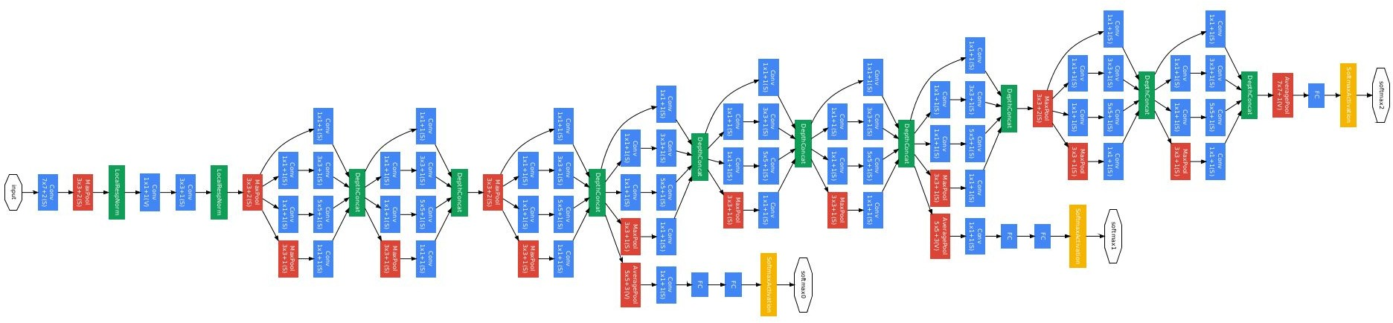
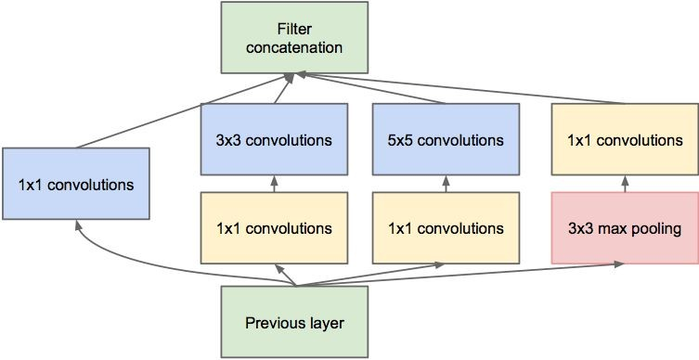
Case Study: GoogLeNet
[Szegedy et al., 2014]
Inception module
ILSVRC 2014 winner (6.7% top 5 error)

Slide 87
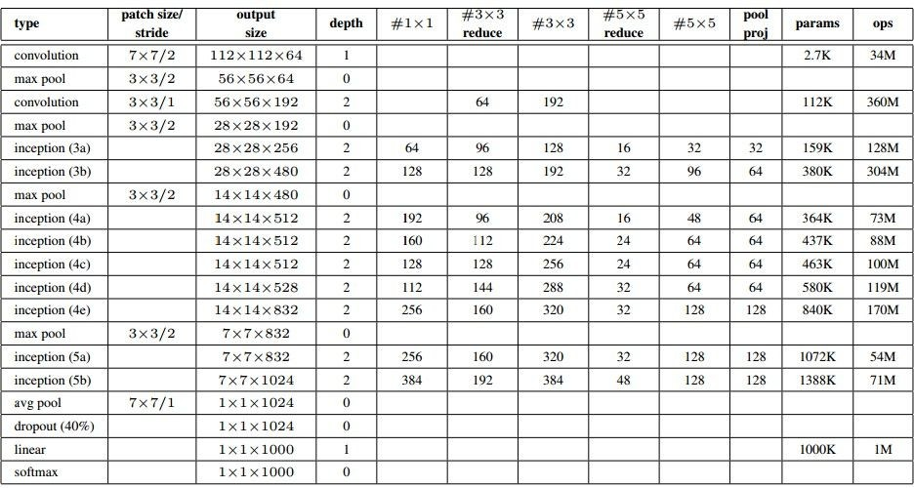
Case Study: GoogLeNet
Fun features:
Only 5 million params! (Removes FC layers completely)
Compared to AlexNet:
12X less params
2x more compute
- 6.67% (vs. 16.4%)

Slide 88
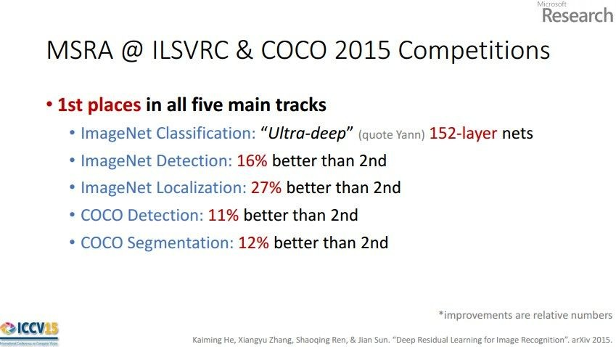
Case Study: ResNet
[He et al., 2015]
ILSVRC 2015 winner (3.6% top 5 error)
Slide from Kaiming He’s recent presentation https://www.youtube.com/watch?v=1PGLj-uKT1w

Slide 89
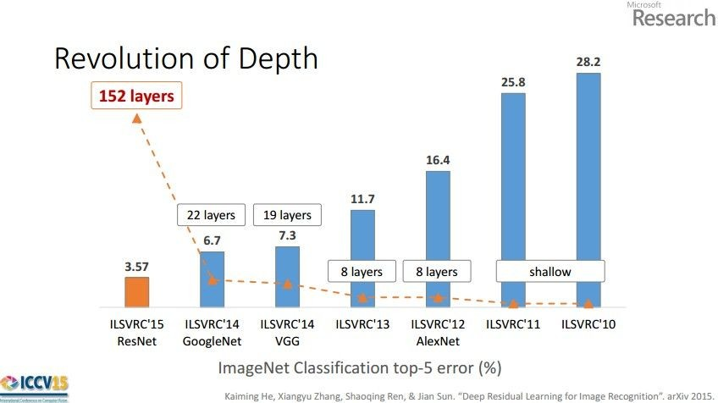
(slide from Kaiming He’s recent presentation)

Slide 90
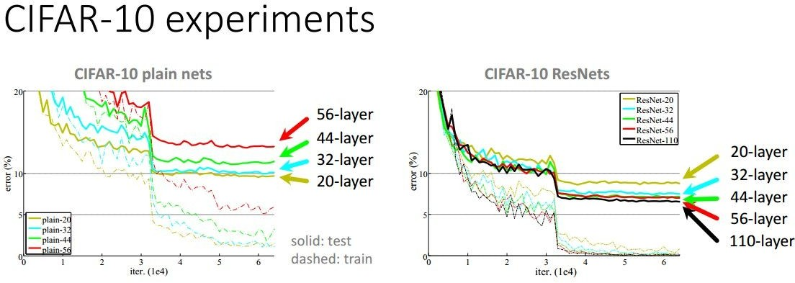

Slide 91
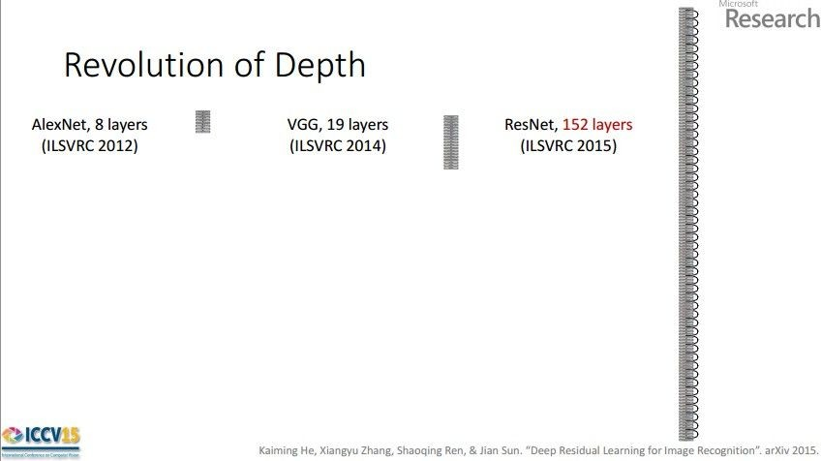
Case Study: ResNet
[He et al., 2015]
ILSVRC 2015 winner (3.6% top 5 error)
2-3 weeks of training on 8 GPU machine
at runtime: faster than a VGGNet! (even though it has 8x more layers)
(slide from Kaiming He’s recent presentation)

Slide 92
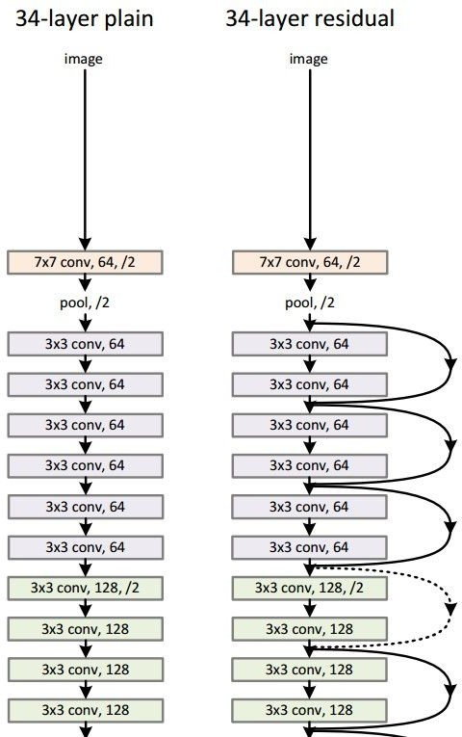
Case Study: ResNet
224x224x3
spatial dimension only 56x56!
[He et al., 2015]

Slide 93
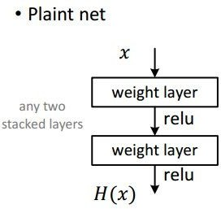
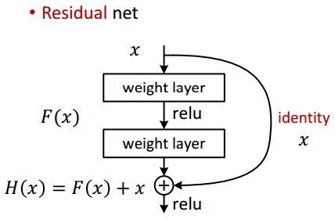
Case Study: ResNet
[He et al., 2015]

Slide 94
Case Study: ResNet
[He et al., 2015]
Batch Normalization after every CONV layer
Xavier/2 initialization from He et al.
SGD + Momentum (0.9)
Learning rate: 0.1, divided by 10 when validation error plateaus
Mini-batch size 256
Weight decay of 1e-5
No dropout used

Slide 95
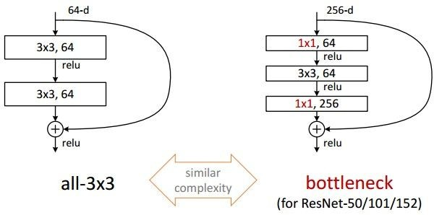
Case Study: ResNet
[He et al., 2015]

Slide 96
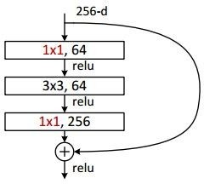
Case Study: ResNet
[He et al., 2015]
(this trick is also used in GoogLeNet)

Slide 97
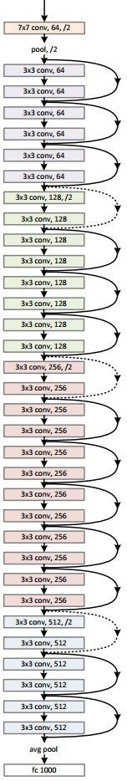
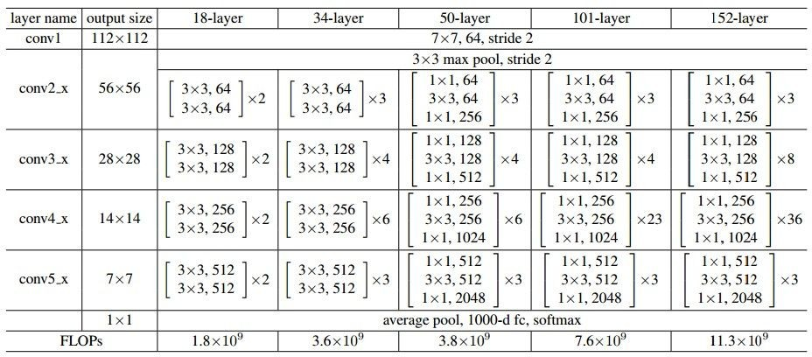
Case Study: ResNet
[He et al., 2015]

Slide 98
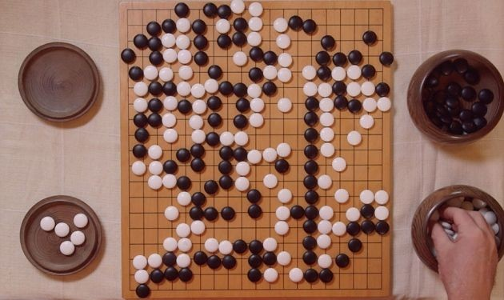
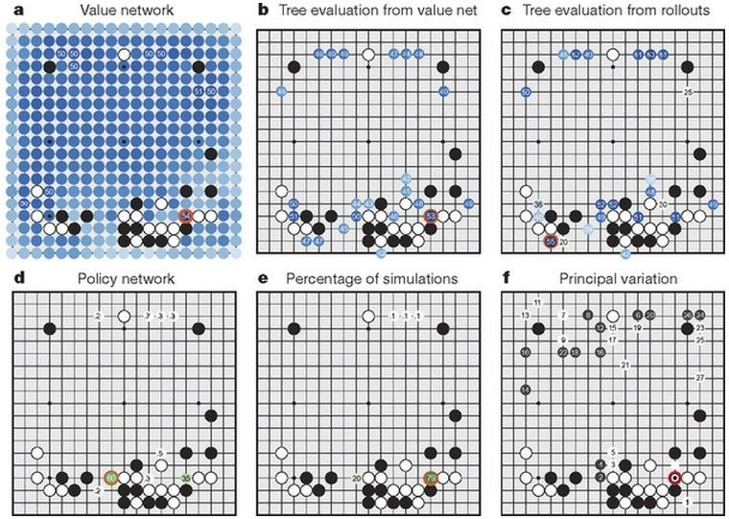

Case Study Bonus: DeepMind’s AlphaGo

Slide 99
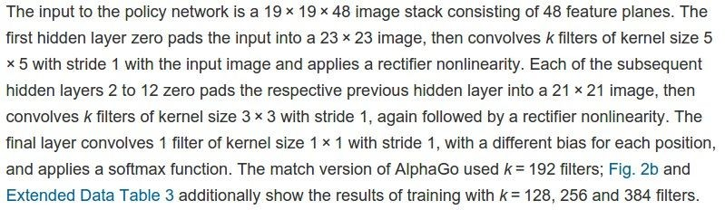
policy network:
[19x19x48] Input
CONV1: 192 5x5 filters , stride 1, pad 2 => [19x19x192] CONV2..12: 192 3x3 filters, stride 1, pad 1 => [19x19x192]
CONV: 1 1x1 filter, stride 1, pad 0 => [19x19] (probability map of promising moves)

Slide 100
Summary
ConvNets stack CONV,POOL,FC layers
Trend towards smaller filters and deeper architectures
Trend towards getting rid of POOL/FC layers (just CONV)
Typical architectures look like
[(CONV-RELU)*N-POOL?]*M-(FC-RELU)*K,SOFTMAX
where N is usually up to ~5, M is large, 0 <= K <= 2.
- but recent advances such as ResNet/GoogLeNet challenge this paradigm

